Slide 1
EV Charging Demand Forecasting
Advanced machine learning analysis of electric vehicle charging patterns across California stations from 2021-2024. This study leverages neural networks, decision trees, and SHAP interpretability frameworks to predict demand patterns and optimize grid infrastructure planning.

Slide 2
Dataset Overview
Data Characteristics
Key Variables
59,810 hourly observations across 3.5 years
Target: EV Charging Demand (kW)
Two California charging stations combined
Renewable energy production (solar + wind)
24 features capturing energy, pricing, infrastructure, and environmental metrics
Grid stability and availability metrics
Weather conditions and temporal features
Temporal granularity: hourly measurements with seasonal patterns

Slide 3




Seasonal Demand Patterns
EV charging demand exhibits distinct seasonal and daily fluctuations driven by renewable energy availability, grid conditions, and user behavior patterns.
Winter
Spring
Highest evening demand, moderate morning usage. Lower renewable production increases grid dependency.
Balanced demand across day periods. Improved renewable energy availability supports efficient charging.
1
2
Autumn
Summer
Stable nighttime demand with moderate fluctuations. Transitional renewable energy patterns.
4
3
Peak afternoon demand coinciding with solar production. Lowest evening renewable output.

Slide 4
Hourly Demand Distribution
Normalized charging demand reveals clear temporal patterns that inform infrastructure planning and load management strategies.
Nighttime (0-6h)
Afternoon (12-18h)
Lowest demand period with normalized values 0.35-0.45. Ideal window for grid-friendly charging.
Peak demand window reaching 0.60-0.65. Maximum solar availability enables renewable charging.
1
2
3
4
Morning (6-12h)
Evening (18-24h)
Gradual increase to 0.50-0.55 as commuters begin charging. Solar production ramps up.
Secondary peak at 0.55-0.60 as users return home. Grid pressure intensifies as solar declines.

Slide 5
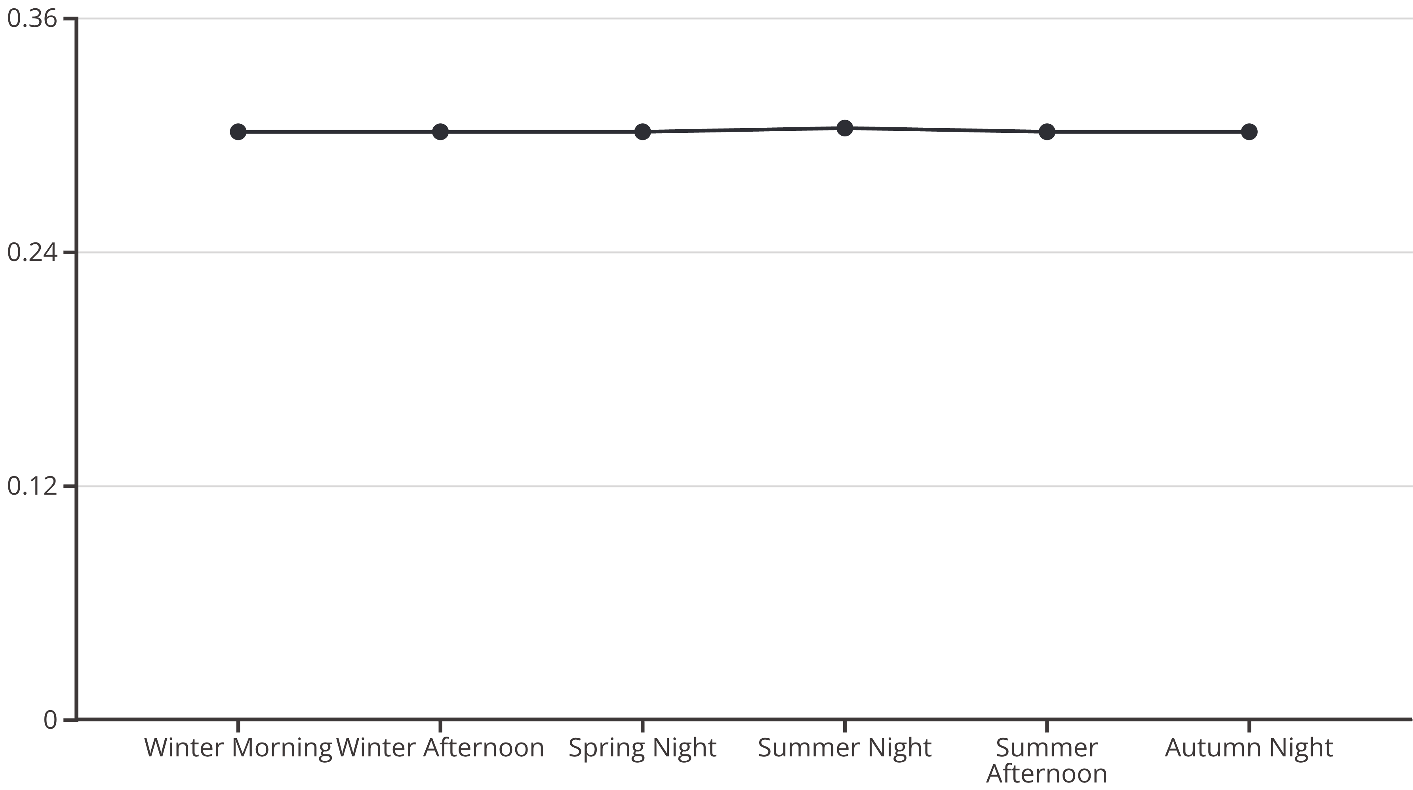
Renewable Energy Production
Total renewable energy production (solar + wind combined) demonstrates seasonal variability that directly influences charging sustainability and grid impact.
Nighttime consistently produces the highest renewable energy across seasons, particularly in summer and spring. This counterintuitive pattern suggests strong wind generation compensates for solar absence, creating optimal conditions for overnight charging strategies.

Slide 6
Weather Impact on Charging Efficiency
Weather conditions significantly influence EV charging efficiency, with normalized efficiency values ranging from 0.45 to 0.53 across different meteorological scenarios.
Sunny Conditions
Cloudy Weather
Partly Cloudy
Highest efficiency at 0.53 normalized. Optimal temperature and solar production create ideal charging environment.
Moderate efficiency at 0.50 normalized. Reduced solar but stable temperatures maintain performance.
Efficiency at 0.49 normalized. Variable conditions create moderate charging performance.
Rainy Periods
Clear Skies
Efficiency at 0.48 normalized. Lower temperatures and humidity impact charging systems.
Lowest efficiency at 0.46 normalized. Extreme temperatures may reduce battery performance.

Slide 7




SHAP Feature Importance Analysis
SHAP (SHapley Additive exPlanations) reveals which factors most strongly influence EV charging demand predictions in our linear regression model.
Renewable Energy Usage (%)
Dominant predictor with strongest impact. Higher renewable usage correlates with reduced grid demand, highlighting sustainability's role in demand patterns.
Electricity Price ($/kWh)
Second most influential feature. Price signals drive user behavior, with higher prices reducing charging demand through load shifting.
Carbon Emissions (kgCO2/kWh)
Third key driver. Higher emissions indicate grid stress, correlating with increased charging demand during peak fossil fuel generation.
Adjusted Charging Demand (kW)
Engineered feature capturing optimized load patterns. Reflects smart charging strategies and demand response programs.

Slide 8
SHAP Model Interpretation
Key Insights
Actionable Insights
The SHAP force plot reveals how individual features push predictions above or below the baseline expected value of 0.139 kW.
Model transparency enables grid operators to understand prediction drivers and implement targeted interventions for demand management.
Renewable energy usage reduction: -0.018 kW impact
Electricity price increase: -0.030 kW impact
Carbon emissions increase: contributing positive shift
Final prediction: 0.091 kW (34% below baseline)

Slide 9
Strategic Recommendations
Maximize Renewable Integration
Dynamic Pricing Incentives
Prioritize charging during high renewable availability windows. Nighttime and morning periods show strongest renewable production, reducing grid stress and carbon footprint.
Leverage electricity price signals to shift demand. Time-of-use rates can flatten demand curves by incentivizing off-peak charging behavior.
Smart Charging Optimization
Carbon Footprint Reduction
Implement demand response programs using adjusted charging demand metrics. Optimize load distribution to minimize peak stress and maximize renewable utilization.
Target low-emission charging windows. Invest in energy efficiency measures and cleaner technologies to support sustainability objectives while managing demand.

Slide 10

Neural Network Architecture
Multi-layer perceptron (MLP) regression model predicts EV charging demand using five key economic and environmental features.
Hidden Layer 1
Input Layer
64 neurons with ReLU activation. Captures complex non-linear relationships between economic and environmental factors.
Five normalized features: Net Energy Cost, Carbon Footprint Reduction, Electricity Price, Carbon Emissions, and Renewable Energy Usage.
Output Layer
Hidden Layer 2
Single neuron producing continuous kW demand prediction. Linear activation for regression output.
32 neurons with ReLU activation. Further feature compression and pattern extraction for demand prediction.

Slide 11
Neural Network Performance
The MLP model demonstrates exceptional predictive accuracy, converging rapidly during training with minimal loss.
0.9978
0.0032
0.0040
13
R² Score
MAE (kW)
RMSE (kW)
Training Epochs
Explains 99.78% of variance in charging demand, indicating near-perfect fit to underlying patterns.
Mean absolute error of just 3.2 watts demonstrates precise predictions at hourly granularity.
Root mean squared error of 4.0 watts confirms minimal prediction deviation from actual values.
Model converged in just 13 iterations, demonstrating efficient learning from strong feature relationships.

Slide 12
Training Convergence
Loss curve analysis reveals rapid optimization with early stopping after convergence detection.
Training Dynamics
Interpretation
Initial loss: 0.00084 (iteration 1)
The steep initial drop followed by gradual refinement indicates the model quickly learned primary relationships between economic/environmental features and demand. Early convergence suggests the five selected features capture the essential dynamics of charging behavior without requiring complex non-linear transformations.
Sharp decline in first 3 epochs
Stabilization by epoch 10
Early stopping at epoch 13
Final loss: 0.00002

Slide 13
Prediction Accuracy Visualization
Actual vs. predicted values demonstrate the neural network's precise tracking of demand fluctuations across 100 test samples.
The model's predictions (marked with X) closely follow actual demand values (marked with circles) across diverse operating conditions. Minimal deviation indicates robust generalization to unseen data, validating the model for deployment in real-world forecasting applications.
This accuracy enables grid operators to anticipate demand with confidence intervals narrow enough for operational decision-making, including capacity planning, renewable integration scheduling, and dynamic pricing implementation.

Slide 14
Decision Tree: Day Period Classification
A decision tree classifier achieves perfect accuracy (100%) predicting time-of-day periods using only month and hour features.
Perfect Classification
Simple Decision Rules
10 Leaf Nodes
Accuracy: 1.00. The model correctly classifies all test samples into Night, Morning, Afternoon, and Evening periods.
Hour-based thresholds provide interpretable splits: Night (0-3, 21-23), Morning (4-11), Afternoon (12-16), Evening (17-20).
Model complexity constrained to maintain interpretability while capturing all essential temporal patterns.
The confusion matrix shows zero misclassifications across all four day period categories, confirming the model's deterministic nature when temporal boundaries are well-defined.

Slide 15




Decision Tree: Seasonal Classification
Season prediction using month, hour, charging demand, and electricity price achieves perfect accuracy (100%), with month being the dominant feature.
Month ≤ 2.5
1
Winter (Jan-Feb)
2.5 < Month ≤ 5.5
2
Spring (Mar-May)
5.5 < Month ≤ 8.5
3
Summer (Jun-Aug)
Month > 8.5
4
Autumn (Sep-Nov)
The tree structure reveals that month alone sufficiently determines season with perfect accuracy, though additional features (demand, price) were available. This demonstrates the deterministic relationship between calendar month and meteorological season.

Slide 16
Understanding Gini Impurity
Technical Definition
Cricket Ball Analogy
Gini impurity measures node purity in classification trees, ranging from 0 (pure) to 0.5 (maximum impurity for binary classification).
Imagine sorting cricket balls by color into boxes. A box with only red balls has Gini = 0 (perfect). A box with equal red and white balls has high Gini (impure).
Gini = 0: All samples belong to one class
The decision tree asks questions like "Is the ball red?" to create progressively purer boxes until each contains only one color (class).
Higher Gini: Mixed class distribution
Decision trees minimize Gini at each split

Slide 17



Grid Availability Prediction
Decision tree classifier predicts grid availability status using electricity price, hour, month, and grid stability index, achieving 95% accuracy.
Primary Feature
Secondary Feature
Temporal Factors
Electricity price ($/kWh) provides the first split. Price ≤ 0.191 strongly indicates grid availability.
Grid stability index refines predictions. Higher stability (>0.516) confirms availability when price is low.
Hour and month provide final classification refinement for borderline cases with mixed indicators.

Slide 18
Grid Availability Decision Rules
The decision tree reveals critical thresholds that determine grid availability status through interpretable if-then rules.
Low Price + High Stability = Available
High Price = Likely Unavailable
Temporal Edge Cases
Prices exceeding $0.191/kWh indicate grid stress, increasing unavailability risk regardless of other factors.
Evening hours (>17:30) and certain months (>6.5) elevate unavailability risk when combined with borderline stability metrics.
When electricity price ≤ $0.191/kWh and grid stability index > 0.516, the grid is reliably available. This represents optimal operating conditions.
These rules enable proactive grid management by identifying high-risk conditions before outages occur.

Slide 19
Model Comparison Summary
Model
Task
Accuracy/R²
Key Features
Neural Network
Demand Prediction
R² = 0.9978
5 economic/environmental
Linear + SHAP
Demand Interpretation
R² = Variable
31 features (full dataset)
Decision Tree
Day Period
100% accuracy
Month, Hour
Decision Tree
Season
100% accuracy
Month (primary)
Decision Tree
Grid Availability
95% accuracy
Price, Stability, Time
Each model serves distinct operational purposes: neural networks for precise forecasting, SHAP for transparency, and decision trees for rapid classification and rule extraction.

Slide 20
Conclusions & Future Directions
Key Findings
Operational Impact
Next Steps
Renewable energy usage and electricity pricing dominate demand patterns. Neural networks achieve near-perfect prediction accuracy. Temporal and grid stability factors enable reliable availability forecasting.
Models enable proactive grid management, renewable integration optimization, and dynamic pricing strategies. Decision tree rules provide actionable thresholds for real-time operations.
Deploy models in pilot programs for demand response validation. Integrate weather forecasting for extended prediction horizons. Expand dataset to additional geographic regions and vehicle types.
This analysis demonstrates the power of combining interpretable and high-performance machine learning approaches to solve complex energy infrastructure challenges.

